Slide 1
Mixtape Bug Hunt
Project 5

Slide 2
Screenshot
Used git log –oneline to display log history
Duplicate log was noted, as a result of completing the same task twice

Slide 3
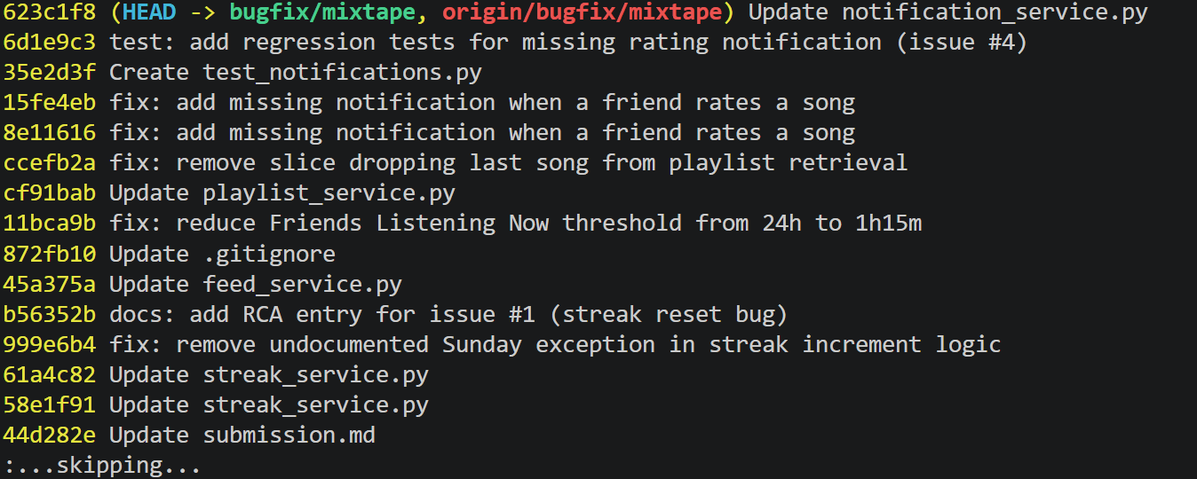
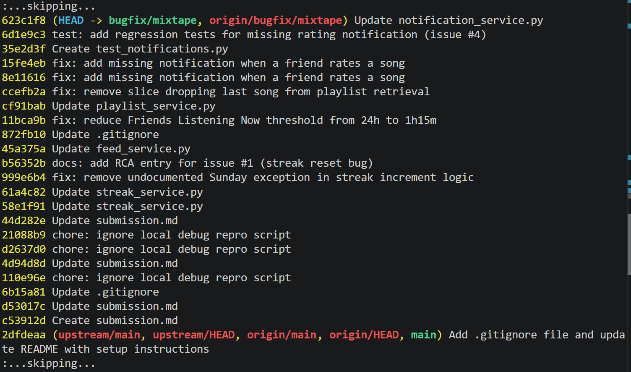
Git Log History
Screenshot
Screenshot

Slide 4
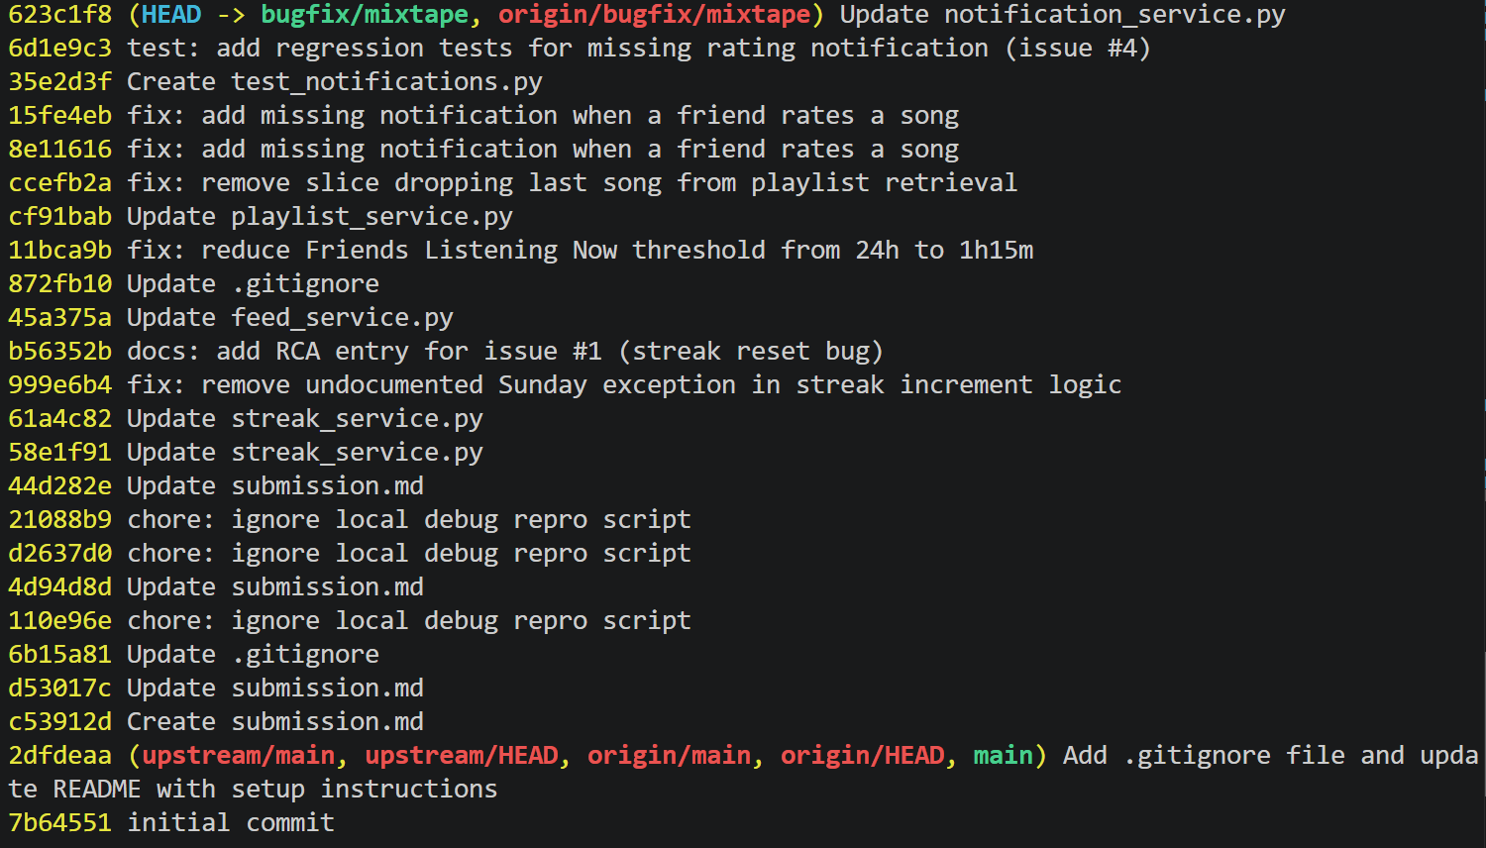
History (contd.)
Screenshot

